Slide 1
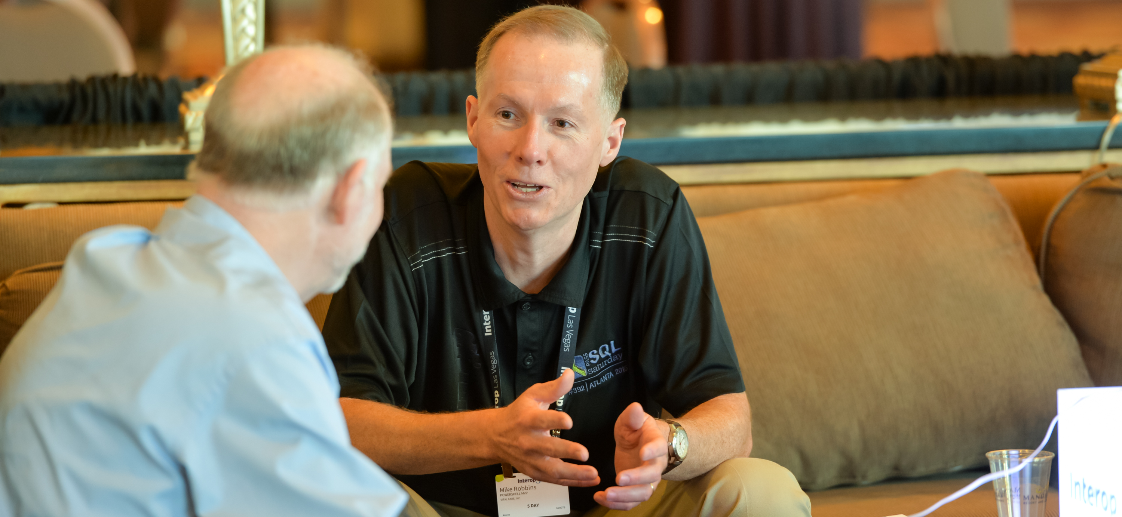


Install PowerShell 7 & essential tools
OnRamp Team
github.com/devops-collective-inc/OnRamp-2025/

Slide 2
Tools to install
PowerShell 7
VS Code
PowerShell extension for VS Code
Windows Terminal (Windows only)
Git
The GitHub CLI
Create a GitHub account (github.com)
Join the OnRamp-2025 Slack channel

